Slide 1
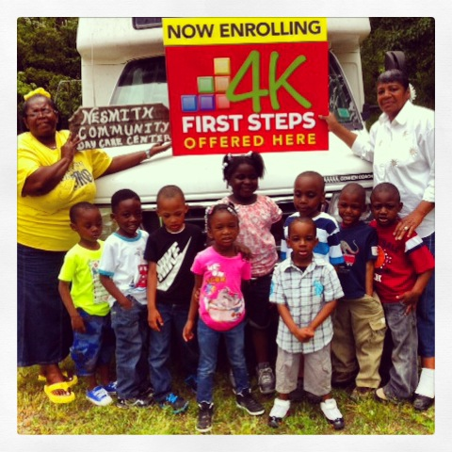
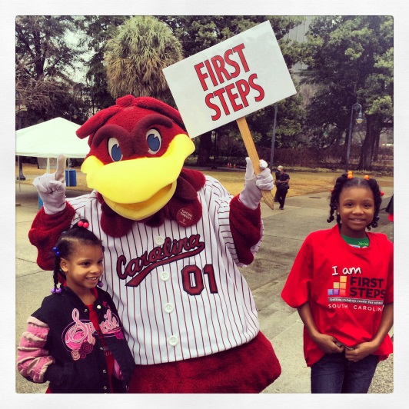
May Leadership
Webinar
May 17, 2016 10:00-11:30 AM
To access this meeting by voice, please dial 888-537-7715,
participant code 43126552#

Slide 2
Today’s Agenda
1. Welcome and Introductions
2. Evidence Based Programs – Dr. Cheri Shapiro,
Institute for Families in Society, USC
3. Parents As Teachers (PAT) Child Care Provider Curriculum -
Donna Hunt O’Brien and Angelique Bay, PAT - Training, Curriculum and Programming
4. Legislative Update
5. Local Program Team Focus Group – discussion summary
6. Program Updates
• 4k
• Baby Net
• Early Head Start
7. Announcements and Key Dates

Slide 3
Evidence Based Programs Update
Cheri Shapiro, Ph.D.
Research Associate Professor
Associate Director
Institute for Families in Society
South Carolina Center for Evidence-Based Intervention, funded by SCDHHS.

Slide 4
Early Care and Education and Parents as Teachers
South Carolina
First Steps Leadership Webinar
May 17, 2016

Slide 5
History of Our Work with ECE

Slide 6
Implementation Design
Program Components:
Personal Visits and Mini-Visits
Groups
Developmental and Health Screenings
Resource Network
Some centers trained classroom teachers as parent educators who served the families of children in their room. Others hired and trained family support personnel to provide services to enrolled families.

Slide 7
Foundational Curricula and Training

Slide 8
3 Roles of a Parent Educator

Slide 9
3 Areas of Emphasis

Slide 10
History of Our Work with ECE

Slide 11
Supporting Care Providers through Personal Visits (SCPV) Curriculum
Designed to support
Family child care providers
Center-based child care staff
Family, friend and neighbor
care providers
Content includes
Professional Resources
Care Provider Handouts
Activity Pages
Parent Handouts

Slide 12
SCPV Curriculum and Training Revision
Updated content and tools for supporting care providers in groups and one-on-one
Specific attention to family, friend, and neighbor care providers
Coaching module
Alignments to Early Childhood Standards and QRIS systems

Slide 13
Legislative Update
Reauthorization Bill
Senate Budget
House Oversight Committee

Slide 14
First Steps Local Program Teams Focus Group Report
9 Executive Directors Participated
Purpose of local teams is to better integrate services to children and families through improved communications at local and state program levels
Build ‘feedback loops’ among all programs locally and to the state office as needed
Give ED’s a systematic way to participate in policy and decision making through an ED Council with committee structure that mirrors the state board
Focus group participants will meet again June 7th to continue work

Slide 15
Renewal Review - Key Dates
March 21 – Renewal Plan Application released
May 6 – Renewal Plans due to state office
May 20 – TA’s complete reviews and get initial feedback to counties
May 27 – TA’s meet to finalize recommendations
June 1 – Final data deadline, P&G Committee meeting materials sent out
June 7– P&G Committee meets
June 16 – State Board meets
June 30 – Feedback on Priority Goals for FY 17 sent out to counties (due back Sept. 30)
June 30-July 15— PAT-APR submitted to portal for review

Slide 16
4K Update
May 20 will be the final checkpoint date for Gold ™ for this school term. Looking forward to the data from our 4K classes!
The last day of the 15-16 term for most 4K classes is Friday, May 27. A few will go a bit later due to bad weather days.
If you are in an approved district and have names of potential centers to share, please contact your Regional Coordinator or Martha.
Our Academy will be August 8-12 for 4K Lead Teachers and Instructional Assistants. We are hosting a Leadership Academy August 30-September 1 for our Directors. Both will be held in Columbia. Details will come out soon and will be shared with you!

Slide 17
4K Territories:
Barbara Black- Chester, Kershaw, Richland, York
Sharon Bruton- Anderson, Cherokee, Oconee, Pickens, Spartanburg, Union
LaDrica Christian- Darlington, Dillon, Florence, Lee, Marlboro, Williamsburg
Kristine Jenkins- Horry, Marion
Cassandra Johnson - Barnwell, Bamberg, Calhoun, Laurens, Sumter
Joy Mazur- Beaufort, Berkeley, Clarendon, Dorchester, Georgetown, Hampton, Jasper, Orangeburg
Marley Via – Aiken, Edgefield, Greenwood, Lexington, Newberry, Saluda

Slide 18
Early Head Start Update
* Refunding application for August 1, 2016 to July 31, 2017 was submitted by May 1st.
* Eleven children have been enrolled at two sites in Allendale and Dillon counties.
* Establishment of a Policy Council made up of parents of these enrolled children.
*Renovations will be completed and furniture delivered to most classrooms by June 6th.
*Pre-Service Training for EHS Teachers at Double Tree Hotel in Columbia May 31st through June3rd.
*Four Family Advocates will be hired June 2nd to serve EHS families in Anderson, Laurens, Saluda, Lexington, Allendale, Bamberg, Dillon, and Orangeburg counties.

Slide 19
BabyNet Update
BabyNet positions are being filled in 5 of 7 BabyNet Districts – of 18 positions 17 have been filled (Sumter coordinator interviews this month)
5 positions at state office are being posted and interviews scheduled in May
BabyNet increased budget request moving through legislative process
Christie Duke at 803-734-4713 or Janice Kilburn 803-730-3084

Slide 20
ANNOUNCEMENTS
CTK teacher training calendar can be found on the CTK Forms page on the SCFS website: http://scfirststeps.com/c2k-forms/
Local Board/Staff Orientation Materials now available at http://scfirststeps.com/training/
Reminder of change in state mileage rate from .575/mile to .54/mile

Slide 21
Partnership Resources http://scfirststeps.com/partnershipresources/
– Accountability
– Child Care
– Countdown to Kindergarten
– Finance
– Governance
– Operations Manual
– Orientation Resources
– Partnership Communications
– Renewal Application Materials
– Resource Development

Slide 22
Fundraising Update
Participation in online giving day 2016:
midlandsgives.org (May 3): Calhoun, Fairfield, Kershaw, Lee, Newberry, Orangeburg, Richland
biggivepeedee.org (May 3): Darlington
lowcountrygivingday.org (May 3): Georgetown
Give Local Lancaster (May 3): Lancaster
Update on 2015 year-end giving campaigns: send your results to Betty

Slide 23
Key Partnership Dates
June 13: State Wide ED Meeting
June 16: State Board of Trustees Meeting
July 15: PAT – APR’s due

