Slide 1
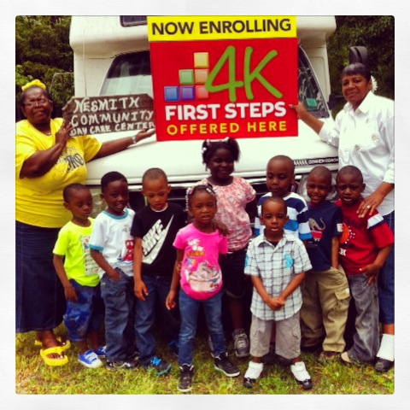
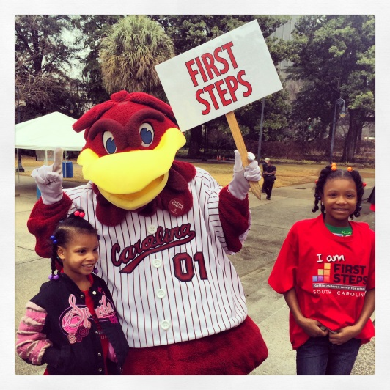
April Leadership
Webinar
April 19, 2016 10:00-11:30 AM
To access this meeting by voice, please dial 888-537-7715,
participant code 52045398#

Slide 2
Today’s Agenda
1. Welcome and Introductions
2. Legislative Update
What’s New at Department of Social Services, Division of Early Care and Education –
(Noelle McInerney, Program and Policy Lead)
4. Finance Update
5. Renewal Review
6. Program Updates
• 4k
• Baby Net
• Early Head Start
7. Announcements and Key Dates

Slide 3
Legislative Update
Reauthorization Bill
Senate Budget
House Oversight Committee

Slide 4
SC Child Care Licensing
SC Voucher
SC Center for Child Care Career Development
ABC Quality
CACFP

Slide 5
SC Voucher
Payment Rate Increases for all age groups
Expanded/New qualification categories:
Homeless Families
Teen Mothers
Special Needs – Section 504 plans

Slide 6
ABC Quality
Quality Standards Revisions
0-2 Age Group
Mandatory
Provider Grants
Service to voucher children in FY 15
Individualized to specific provider needs
Three Categories
Due by 6/30/16

Slide 7
Center for Child Care Career Development
Student ID System
Health and Safety Pre-Service Certificate
Due to new CCDF law requirements for pre-service training
Free to providers
Covers all content areas required by licensing law
Two year credit for caregiver
$100 bonus
Certificates completed:
In progress:

Slide 8
HOW CAN YOU HELP?

Slide 9
Questions???
Noelle McInerney
Noelle.Mcinerney@dss.sc.gov
803-898-5435
864-905-2581

Slide 10
Finance Update
Deadlines For FY16
All Fund 56 carry forward must be spent by June 30, 2016.
All goods and services must be received by June 30, 2016.
You must show proof that the goods were received on or before
June 30, 2016.
All FY16 invoices must be received by the RFMs by July 31, 2016.
All FY16 In-Kind documentation must be received by the RFM by July 31, 2016.
All FY16 reallocations must be received by August 31, 2016.

Slide 11
Finance Update
Basic Reminders for Preparing FY17 Renewal BSP
Use your most recent BSP for the current fiscal year.
Use the FS Operations Manual, specifically Chapter 5 – The Accounting Coding System to use as a resource for questions.
Percentages throughout the BSP must be increments of 5.
Cells containing formulas should not be typed over throughout the BSP.
On the Summary page make sure your totals for Fund 55 do not exceed the allocated amount.
More specific instructions are given in the Budget Spending Plan Preparation Guide. Please contact your state office TA to receive a copy of this guide. You may also contact Beverly Mills for questions concerning preparation of the renewal BSP at 803-732-0413 or bmills@firststeps.org.

Slide 12
Renewal Review
Strategy Self Assessment Checklists – example of use (Berkeley)
Review of Conditional Approval
Key Dates

Slide 13
Strategy Self Assessment Checklists
For each program standard and “Other” strategies
Posted to the web site under Partnership Resources/Accountability
You do NOT have to turn in checklists to SC First Steps
Use to report on strategy successes, as well as challenges/compliance issues, in the Renewal Plan
TA Team resource for strategy reviews

Slide 14
Conditional Approval Codes (separate document)
Provides benchmarks used by the TA Team to assess whether a strategy should receive a conditional approval

Slide 15
Requirements for Renewal Plan Approval
In order for partnership’s 2016-17 plan review to be completed for state board consideration:
All components of the Renewal Plan must be submitted, including all attachments
Responses to requests for more information regarding one or more strategies must be received
Partnership by-laws certificate (signed) and resolution of adoption are on file with SC First Steps
Renewal BSP (with proposed budget increase) has an administrative percentage no greater than 8%

Slide 16
Key Dates
March 21 – Renewal Plan Application released
May 6 – Renewal Plans due to state office
May 20 – TA’s complete reviews and get initial feedback to counties
May 27 – TA’s meet to finalize recommendations
June 1 – Final data deadline, P&G Committee meeting materials sent out
June 8 – P&G Committee meets
June 16 – State Board meets
June 30 – Feedback on Priority Goals for FY 17 sent out to counties (due back Sept. 30)

Slide 17
4K Update
All EDs in approved counties have been contacted by our Regional Coordinators for collaboration. Let us know at any time if you have updates to share.
Renewed 4K centers have received the student application for 16-17. Please communicate the information for all choices of 4K in your county to parents.
We are working to visit our 4K classrooms for a baseline for ECERS-3 assessments. We will use the data to develop a comprehensive plan for quality improvement.
May 20 will be the final checkpoint date for Gold ™ for this school term in our 4K classes.
Our Academy will be August 8-12 for 4K Lead Teachers and Instructional Assistants. We are hosting a Leadership Academy August 30-September 1 for our Directors. Both will be held in Columbia. Details will come out soon and will be shared with you!

Slide 18
4K Territories:
Barbara Black- Chester, Kershaw, Richland, York
Sharon Bruton- Anderson, Cherokee, Oconee, Pickens, Spartanburg, Union
LaDrica Christian- Darlington, Dillon, Florence, Lee, Marlboro, Williamsburg
Kristine Jenkins- Horry, Marion
Cassandra Johnson - Barnwell, Bamberg, Calhoun, Laurens, Sumter
Joy Mazur- Beaufort, Berkeley, Clarendon, Dorchester, Georgetown, Hampton, Jasper, Orangeburg
Marley Via – Aiken, Edgefield, Greenwood, Lexington, Newberry, Saluda

Slide 19
Early Head Start Update
Submission of refunding application on May 1st
Board will talk about the new EHS-CCP expansion funding opportunity this week
Renovations at 13 of the 15 centers are in process.
Four centers in Allendale, Saluda, Dillon, and Lexington are targeted to be the first to enroll children.
Contracts with the 12 local partnerships to hire/house Family Advocates are being developed
Pre-Service Training will be offered May 31-June 3^{rd –} Executive Directors from the 12 counties are invited.

Slide 20
BabyNet Update
BabyNet positions are being filled in 5 of 7 BabyNet Districts – of 18 positions 16 have been filled (Florence and Sumter in process)
5 positions at state office are being posted and interviews scheduled in May
BabyNet increased budget request moving through legislative process
Christie Duke at 803-734-4713 or Janice Kilburn 803-730-3084

Slide 21
ANNOUNCEMENTS
CTK Teacher Training
New participant code for Partnership Conference Call Line: 43126552#
Fund Raising Update
Data System Update – Training Outputs
Local Board/Staff Orientation Materials now available on First Steps website

Slide 22
Fundraising Update
Participation in online giving day 2016:
midlandsgives.org (May 3): Calhoun, Fairfield, Kershaw, Lee, Newberry, Orangeburg, Richland
biggivepeedee.org (May 3): Darlington
lowcountrygivingday.org (May 3): Georgetown
Update on 2015 year-end giving campaigns: send your results to Betty

Slide 23
Data System Update: Child Care Training Outputs Screen
Training Hours by CCCCD Topic Area (item 24) was missing two areas:
Nutrition
Special Needs
Outputs screen and Outputs Summary Report have been updated
On Renewal Plan, indicate any Nutrition training topics with “N” and Special Needs topics with “S”

Slide 24
Key Partnership Dates
May 2nd – 5th : Smart Start Conference
May 6: Renewal Plans Due
May 17: ED Meeting or Webinar?
June 16: State Board of Trustees Meeting
July 15: PAT – APR’s due

