Slide 1
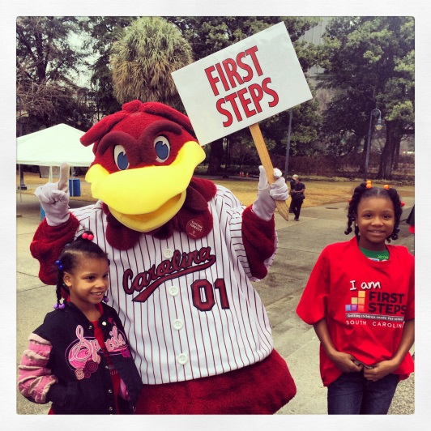
January Leadership
Webinar
January 19, 2015
10:00-11:00 AM
To access this meeting by voice, please dial 888-537-7715,
participant code 52045398#

Slide 2
Today’s Agenda
Welcome and Introductions
Legislative Update
I CAN Public Information Campaign
Finance Update
Data System Update
Partnership & Program Accountability Standards
Professional Development Opportunities
SCANPO
Board Orientation – Board Elections
4 K Update
Early Head Start Update
Baby Net Update
Announcements and Key Dates

Slide 3
Legislative Update
Governor Haley’s proposal
Reauthorization Bill
Executive Budget
House Ways and Means
House Oversight Committee

Slide 4
I CAN CAMPAIGN

Slide 6
[I CAN]: Child Statements
Yard signs – move locations if applicable. Have more signs available
Currently in Phase One (child statements)
Billboards going up now with child statements, transition to adult statements in 4 weeks
Web site, Facebook, Twitter: Please like, share, etc.
ALL partnerships should have a Facebook page
Child statements available for partnerships via Dropbox in multiple sizes: Facebook banner, Instagram, newspaper ad https://www.dropbox.com/sh/sfnwul88865am7i/AABdefcWss9qDEswDyLyVAqPa?dl=0

Slide 7
Facebook Banner I Can Media/I Can Media Images

Slide 8
Instagram I Can Media/I Can Media Images

Slide 9
Newspaper ad I Can Media/I Can Media Images

Slide 10
[I CAN]: Adult Statements
Creating adult graphics, will post to Dropbox in partnership folders
Please send in your adult statements and high quality photos
Will select graphics for billboards
Will add commitment form to web site soon

Slide 11
I Can Media/(your county folder)

Slide 12
I Can Media/(your county folder)

Slide 13
I CAN: Phase THREE (MARCH-APRIL)
COMMITMENTS
I DID… (vs I CAN)
WEEK OF THE YOUNG CHILD OPPORTUNITY
April 10-16

Slide 14
Finance Update

Slide 15
Data System Update

Slide 16
Data System Reminders
Quarters 1 and 2 data (through Dec. 31) should be in the system by January 31 for mid-year data check
Conditional approval updates to the state board will be based on mid-year data
Reminder of new features in the data system for FY16:
Child care training strategies must enter follow-up visits to providers
New outputs data entry screen for Community Education (8022) and Child Care Training
TA waiver for funding child care scholarships to providers that do not meet program standards (under Approve Providers)
Changes to Child Care Provider Data Screens:
Ability to code visit activity by strategy, filter in reports
ABC level at program entry vs. most recent ABC level
Entering intensity level of services to providers (intensive(QE), consultation, training only)
Completion of new Health and Safety training requirement

Slide 17
Partnership & Program Accountability Standards

Slide 18
Time Line
Jan. 19 – Solicit input from partnerships for FY 17 Accountability Standards
Feb. 1 – Post Draft FY 17 Accountability Standards on website - continued review
Feb. 1- 15 – Comment period for standards
March 9 - Program and Grants Committee reviews FY 17 standards and adopts recommendation for State Board
March 17 – State Board adopts FY 17 Accountability Standards
March 18 – release of FY 17 Accountability Standards

Slide 19
Professional Development Opportunities

Slide 20
SCANPO Summit
First Steps Executive Directors Meeting – March 9th – first evening of SCANPO Summit
Partnerships registered to date:
Greenville Orangeburg
Kershaw McCormick
Laurens Fairfield
Allendale Horry
Saluda

Slide 21
4K Update
Education Oversight Committee 4K report released late Friday:
Private 4K students’ early literacy results on Circle were superior in 4K and roughly equivalent in 5K (Circle).
Private providers receiving significantly more training and technical assistance.
Private providers reported:
Being better prepared to administer the Circle
Using the results to meaningfully inform instruction
Administering the Circle more often (mid-year, year-end)
Using data in inform parents

Slide 22
4K Update
The application for new centers for 16-17 is on our website. We appreciate referrals from our EDs!
Renewed centers have received the student application for 16-17.
ECERS 3 news- Participants included 8 of the 4K Team, 14 from our County Partnership Team, and 6 partners from CCR&R. It was a great week and we look to support the use of ECERS 3 in SC.
We welcome Sharon Bruton to our 4K Family!

Slide 23
4K Territories:
Barbara Black- Chester, Kershaw, Richland, York
Sharon Bruton- Anderson, Cherokee, Oconee, Pickens, Spartanburg, Union
LaDrica Christian- Darlington, Dillon, Florence, Lee, Marlboro, Williamsburg
Kristine Jenkins- Horry, Marion
Cassandra Johnson - Barnwell, Bamberg, Calhoun, Laurens, Sumter
Joy Mazur- Beaufort, Berkeley, Clarendon, Dorchester, Georgetown, Hampton, Jasper, Orangeburg
Marley Via – Aiken, Edgefield, Greenwood, Lexington, Newberry, Saluda

Slide 24
Early Head Start Update
15 anticipated partner sites in 12 counties.
Building inspections underway to identify necessary renovations.
Contracts to be issued in coming days.

Slide 25
BabyNet Update
Planning with agency partners, state and local is underway to improve system intake.
Initial Intake Coordinator and System Point of Entry Supervisor positions are being hired in 5 of 7 BabyNet Districts
Policy revisions are underway with BabyNet Program Managers’ workgroup
Budget request submitted to Governor’s Office and General Assembly for additional improvements identified in BN Think Tank sessions
Christie Duke at 803-734-4713 or Janice Kilburn 803-730-3084

Slide 26
ANNOUNCEMENTS
Local Board Orientation Materials
CTK Planning Group
Upcoming PAT Training Opportunities

Slide 27
Key Partnership Dates
January 27: ED and Board Chair Forum 11:00 AM
State Board Meeting (note date change)
February 16-17: First Steps ED Leadership Meeting
March 9-11: SCANPO – South Carolina’s Nonprofit Summit
April 10-16: Week of the Young Child 2016

