Slide 1
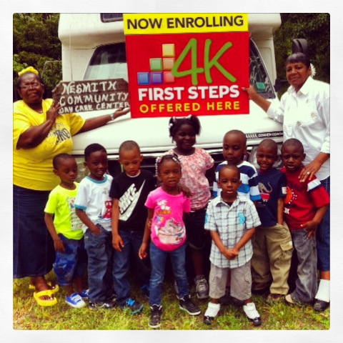
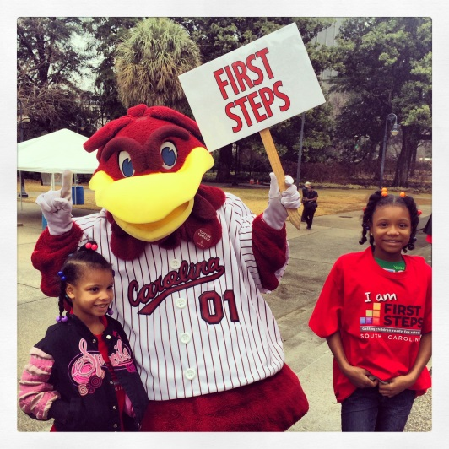
March Leadership
Webinar
March24, 2015
10:00-11:30am
To access this meeting by voice, please dial 888-537-7715,
participant code 52045398#
Notes:
Hello and welcome to Part 1 of Starting Small: The First Steps Guide to Early Literacy.

Slide 2
Today’s Agenda
Welcome and introductions
State Board Update
Legislative Update
3. FY 16 Renewal
Timeline
Partnership & Program Accountability Standards Changes
Renewal Plan Template
4. 4-K Update
5. Baby Net Update
Announcements

Slide 3
FY 16 Renewal Timeline
March 19 – State Board Meeting - Review and adoption of proposed FY16 Program Standards and Tentative Partnership Allocations by State BOT
March 20- Renewal Plan Template, FY 16 Standards and Projected Allocations sent out
March 24 – Webinar to review Renewal Plan Template
April 30 –Data entry completed (as much as possible)
May 8 - Final date for FY 16 Renewal Plan submission (7 weeks from when sent out)
June 2– Data entry deadline for renewal plan review
June 18– State BOT review and renewal plan approval
Tuesday, March 24 at 10am

Slide 4
FY16 PARTNERSHIP STANDARDS

Slide 5
Proposed FY16 Partnership and Program Accountability Standards Effective July 1, 2015 – June 30, 2016
Outline expectations for local First Steps Partnerships regarding programmatic, operational, financial, and administrative activities
Updated annually by State Board of Trustees
Attached to the 2015-16 grant agreement
Organized in two sections:
Partnership
Program

Slide 6
Conditional Approvals
Findings of non-compliance, issued by the Board of Trustees upon recommendation by the State Office, during renewal review
Local partnership must submit a compliance plan that includes TA and monitoring.
Conditional Approvals are attached to the partnership’s grant agreement as a contractual obligation.

Slide 7
SECTION 1: FIRST STEPS PARTNERSHIP ACCOUNTABILITY STANDARDS
GOVERNANCE AND OPERATIONS
Additions as per Act 287:
10. Local partnerships shall maintain a current local board roster with email contact information on file with SCFS (Section 11. Section 59-152-60(A)).
11. Local partnerships shall submit signed, electronic copies of board minutes for the prior fiscal year to SCFS, on behalf of the state board, by the deadline for submitting partnership Annual Reports (Section 11. Section 59-152-70(A)(8)).

Slide 8
SECTION 1: FIRST STEPS PARTNERSHIP ACCOUNTABILITY STANDARDS
FISCAL ACCOUNTABILITY
Finance Office will certify available carry-forward per partnership by October 15.
Partnerships with FY 15 carry-forward exceeding 15% of their FY16 state allocation must submit a written justification and plan to reduce their amount of carry-forward to 15% or lower by the following fiscal year (FY17).
Partnerships whose carry-forward exceeds 15% for two or more fiscal years will be subject to conditional approval and potential withholding of grant funds at the discretion of the First Steps Board of Trustees

Slide 9
SECTION 2: PROGRAM ACCOUNTABILITY STANDARDS
Partnerships funding home visiting shall work in collaboration with SC First Steps to ensure full compliance with First Steps program standards and national model guidelines.
Standards now include attachment of each model’s fidelity requirements for clarity.
Detail added to assessment section regarding KIPS and ACIRI

Slide 10
SECTION 2: PROGRAM ACCOUNTABILITY STANDARDS
Three new risk factors added for targeting:
English is not primary language spoken in the home, when combined with one or more additional risk factors
Single parent household and has need of other services
Transient/numerous family relocations and/or homeless

Slide 11
SECTION 2: PROGRAM ACCOUNTABILITY STANDARDS
EARLY IDENTIFICATION AND REFERRAL
Serve as a local portal connecting families with young children with suspected delays in development to community-based services
Target: any child ages birth to five years with suspected delays in development
For child> 34.5 months - referral to the local school district for IDEA Part B services.

Slide 12
SECTION 2: PROGRAM ACCOUNTABILITY STANDARDS
CHILD CARE QUALITY ENHANCEMENT
Definitions of consultation, coaching and mentoring added to align with Evidence Based Best Practice descriptions
CHILD CARE TRAINING
Partnerships will use the FS online data collection system to track follow-up visits and other consultation activities with child care providers.

Slide 13
ANNOUNCEMENTS
Read-In TUESDAY, APRIL 14, 2015
BOOKS ON PARADE at the 2015 SC Read-In! Bring your favorite book to read on the State House grounds after the event.
Register by April 1 - http://read-in-sc.org/
Celebrate NAEYC's Week of the Young Child™ April 12 –18, 2015 Partnership Board Meeting – Columbia
CTK Planning
Send preliminary count to Samantha Ingram
Toolkit order forms and CTK fax back forms sent out 3/20/15
Other Announcements – news from the partnerships

Slide 14
2015 Calendar
March 26th , 1:00 PM – First Steps Study Committee. 110 Blatt Building
April 14th, 1:00 to 4:00 PM -Board To Board Dialogue and Planning Session
State Wide ED Meeting Dates
March 5, Thursday
May 14, Thursday
September 10, Thursday
November 19, Thursday
June 18th, 2:00 PM- FirstSteps State Board Meeting

