Slide 1
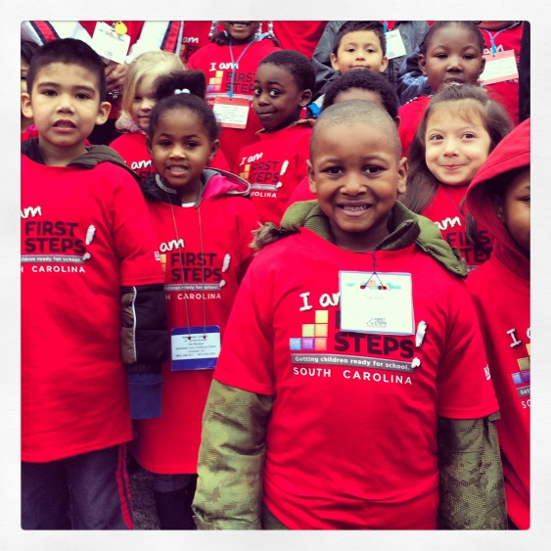

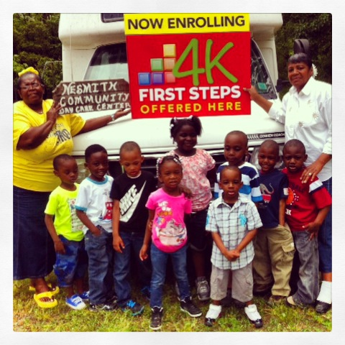
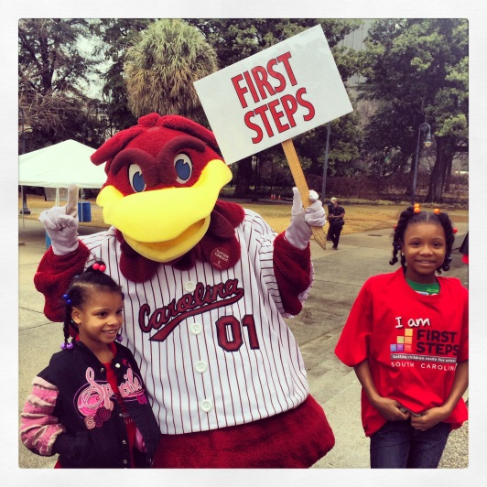
February Leadership
Webinar
February 17, 2015
10:00-11:30am
To access this meeting by voice, please dial 888-537-7715,
participant code 52045398#
Notes:
Hello and welcome to Part 1 of Starting Small: The First Steps Guide to Early Literacy.

Slide 2
Today’s Agenda
Welcome and introductions
2. Legislative Update
  School Readiness Assessment Briefing - Feb.18, 8:45-10 AM, Blatt Room 321
3. State Board Update
4. FY 16 Renewal
  Planning and Timeline
  Partnership & Program Accountability Standards
  Local Needs Assessments
5. 4-K Update
  mClass Circle Assessment - initial results
  enrollment activities for 2016
6. Baby Net Update
7. Announcements

Slide 3
FY 16 Renewal Planning Timeline
March 19 – State Board Meeting - Review and adoption of proposed FY16 Program Standards and Tentative Partnership Allocations by State BOT
March 20- Renewal Plan Template, FY 16 Standards and Projected Allocations sent out
March 24 – Webinar to review Renewal Plan Template
May 1 – Deadline for requesting extension for renewal plan submission
May 8 - Final date for FY 16 Renewal Plan submission (7 weeks from when sent out)
May 15 – Final date for FY 16 Renewal Plans granted extension
June 5 – Data entry deadline for renewal plan review
June 18– State BOT review and renewal plan approval

Slide 4
FY 15 Partnership & Program Accountability Standards
Soliciting feedback – January thru March 13
Update on proposed changes to date – February 17 webinar
Final changes submitted to staff by March 2nd
Adopted by BOT March 19th
Review of FY 16 Standards (high level, changes only) – March 24 webinar

Slide 5
Local Needs Assessment
Complement to existing needs assessments already underway
State-level update of demographics
Utilize data provided by Compass – local profiles, state level data broken out by county
More extensive needs assessment in FY17 and within Strategic Planning process

Slide 6


Slide 7
mCLASS:CIRCLE Overview mClass Circle is a computer-administered early literacy assessment administered to all publicly-funded 4- and 5-year-old kindergartners in South Carolina.
This assessment targets the skills research shows are critical for Kindergarten success and lead to reading proficiency by third grade.

Slide 8
mCLASS:CIRCLE –
Fall 2014 Administration
First Steps 4K administered the Circle to 1,818 students enrolled in its private, four-year-old kindergarten programs in September and October 2014, successfully assessing more than 99% of enrolled students within the required 45-day testing window.
THE RESULTS:
The baseline data to follow reflects competencies of 2014-2015
4K students at the time of enrollment.

Slide 9
What does CIRCLE measure?
Individual Assessments Observation Checklists
Required for 14-15:
Letter Naming
Vocabulary
Phonological Awareness (7 subskills)
Optional:
Mathematics
Science
Social Studies
**Math, Social/Emotional, and Physical Development by 16-17
Required for 14-15:
Early Writing
Social and Emotional Development
Book and Print Awareness
Optional:
Approaches to Learning
Creative Arts Expression
Physical Development and Health
Notes:
PA broken down into 6 subskills - Listening, Rhyming 1 & 2, Alliteration, Words in a Sentence, Syllabication, Onset-Rime
Checklists- emerging(never, rarely), developing (sometimes), proficient (consistently)
Book & Print Awareness checklist based on Marie Clay’s An Observation Survey on Early Literacy Achievement

Slide 10
LETTER NAMING
-Timed, the # of upper/lower letters identified
-Baseline proficient is 9 for 4-4.5 age and 11 for 4.5+ named in 60 seconds
SCFS: 42% PROFICIENT

Slide 11
VOCABULARY
-Timed, name pictures of objects
-Baseline proficient is 17 for age 4-4.5 or 21 for age 4.5+ named in 60 seconds
SCFS: 36% PROFICIENT

Slide 12
PA #1 - LISTENING
-Do 2 words sound “the same”?
- Baseline proficient for 4K is 5 out of 5 correct
PHONOLOGICAL AWARENESS (PA)
is the ability to recognize that the spoken word is made up of a variety of sound units. It is a reliable predictor of reading success. PA is divided into 7 subskills and then a composite score is aggregated for all.
SCFS: 46% PROFICIENT

Slide 13
PA #2 – RHYMING, part 1
- Untimed, ability to distinguish whether 2 spoken words rhyme
- Baseline for 4K is at least 7 out of 9 correct
SCFS: 34% PROFICIENT

Slide 14
PA #3 - RHYMING, part 2
- Untimed, ability to independently give a word that rhymes with the given word
- baseline proficient for 4K names at least 3 rhyming words given 5 prompts
SCFS: 22% PROFICIENT

Slide 15
PA #4 – ALLITERATION
- Untimed, ability to identify 2 words with the same beginning sound
- Baseline proficient for 4K is at least 6 out of 7
SCFS: 20% PROFICIENT

Slide 16
PA #5 - WORDS IN A SENTENCE
- Untimed, ability to move counters to show how many words are in a sentence
- Baseline proficient is naming the correct number of words in at least 4 out of 5 sentences
38% PROFICIENT

Slide 17
PA #6 - SYLLABICATION
- Untimed, separate a spoken word into syllables
- Baseline proficient for 4K correctly count/clap at least 6 of 7 words
35% PROFICIENT

Slide 18
PA #7 - ONSET-RIME
- Untimed, able to segment beginning sound from rest of word
- Baseline proficient is ability to correctly segment at least 3 of 5 words given
38% PROFICIENT

Slide 19
PA COMPOSITE (all 7)
Baseline proficient is at least 11 for ages 4-4.5 or 14 for ages 4.5+
SCFS: 94% PROFICIENT

Slide 20
In Summary:
South Carolina’s low-income four-year-olds are presenting for enrollment with deficiencies in key early literacy skills.
In particular, a weakness in vocabulary is noted, with only 36% of SCFS students meeting beginning of the year expectations.
This is consistent with well-established national data suggesting gaps in the language exposure of low income children.

Slide 21
What’s Next:
Instruction: mClass Circle is designed to assist teachers in identifying and addressing specific early literacy needs.
Community Planning: Need to work within local communities to stress the importance of language and literacy development from birth to four. This is the combined work of families, preschool providers, the faith community and a host of other stakeholders.

Slide 22

First Steps 4K 2015-2016
SPARTANBURG
CHEROKEE
YORK
PICKENS
GREENVILLE
7
3
1
6
4
OCONEE
UNION
CHESTER
LANCASTER
4 5
ANDERSON 2
55
CHESTERFIELD
MARLBORO
ANDERSON
LAURENS
3
56
FAIRFIELD
DARLINGTON
4
51
NEWBERRY
KERSHAW
3
DILLON
ABBEVILLE
52
GREENWOOD
50
LEE
1
MARION
2
GREENWOOD
4
1
SALUDA
LEXINGTON
RICHLAND
1
FLORENCE
7
MCCORMICK
3
2
RICHLAND
SUMTER
3
2
4
3
5
EDGEFIELD
CALHOUN
2
HORRY
5
ORANGEBURG
CLARENDON
WILLIAMSBURG
AIKEN
1
3
GEORGETOWN
19
4
29
BARNWELL
45
BAMBERG
2 1
BERKELEY
SRS
4
64 Likely Districts:
With Inclusion of Anderson 2, Anderson 5 and Kershaw.
DORCHESTER
ALLENDALE
1
COLLETON
2
HAMPTON
CHARLESTON
2
JASPER
BEAUFORT

Slide 23
Upcoming First Steps 4K Dates
March 13, 2015- Pre-writing and language experiences, small group and modeling, parenting activities
Professional Development Day to be held in 4 regional sites.
Academy 2015
July 27- July 31

Slide 24


Slide 25

ANNOUNCEMENTS
2nd Annual SC Librarians Vote - Children’s Book of the Year

Slide 26
ANNOUNCEMENTS
Read-In TUESDAY, APRIL 14, 2015
BOOKS ON PARADE at the 2015 SC Read-In! Bring your favorite book to read on the State House grounds after the event.
Register by April 1 - http://read-in-sc.org/
Celebrate NAEYC's Week of the Young Child™ April 12 –18, 2015 Partnership Board Meeting – Columbia
CTK Planning
Send preliminary count to Samantha Ingram by March 5th
Toolkit Price Increase (4 more books added)
Other Announcements – news from the partnerships

Slide 27
e-Professional Development
24/7 accessibility to early childhood courses
Approved for DSS credits and CEU’s
Each course 2 to 4 hours long
Engaging, interaction and relevant
TO LEARN MORE – JOIN A WEBINAR:
Tuesday, February 24 from 10-11 a.m.
RSVP - Gillian Gansler ggansler@qassist.com
Questions - Call 404-591-2545

Slide 28
2015 Calendar
State Wide Meeting Dates
March 5, Thursday
May 14, Thursday
September 10, Thursday
November 19, Thursday
PARTNERSHIP WEBINARS – 3^{RD*} Tuesday of each month
*May be alternative Tuesday if close to ED statewide meeting

Slide 29
MARCH 5TH - TOPICS
Evidence Based and Evidence Informed Programs
Community Convening around School Readiness Data (mCircle)
Feedback from Partnership Survey
Overview of Strategic Planning Process
  Needs and resource assessment

