Slide 1


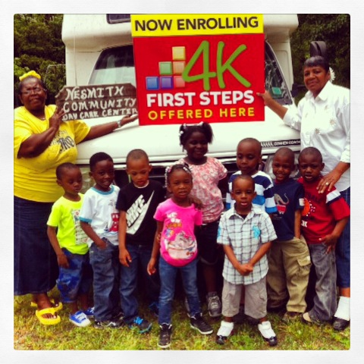
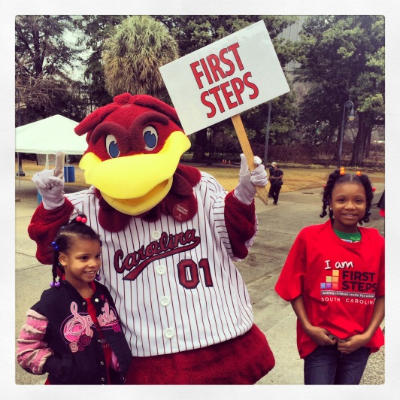
January Partnership
Webinar
January 27, 2015
10:00-11:00am
To access this meeting by voice, please dial 888-537-7715,
participant code 52045398#
Notes:
Hello and welcome to Part 1 of Starting Small: The First Steps Guide to Early Literacy.

Slide 2
Today’s Agenda
1. Welcome and announcements
2. 2016 Calendar
3. Report from the January State Board Meeting
4. Legislative Update
5. FY 15 Partnership & Program Accountability Standards
6. Regional Collaboration – Logo
7. 4-K Update
8. Baby Net Update
9. Announcements

Slide 3
2016 Calendar
State Wide Meeting Dates
March 5, Thursday
May 14, Thursday
September 10, Thursday
November 19, Thursday
PARTNERSHIP WEBINARS – 3^{RD*} Tuesday of each month
*May be alternative Tuesday if close to ED statewide meeting

Slide 4
Feed-back from ED’s
Webinars too long – need information in advance so that webinar can be used for clarification
More networking opportunities
Hold annual meeting of State and Local Boards
State office staff meet with counties with similar programs and needs to facilitate sharing useful information
Quarterly in-person state wide meetings

Slide 5
FY 15 Partnership & Program Accountability Standards
Soliciting feedback – January thru March 13
Update on proposed changes to date – February 17 webinar
Adopted by BOT March 19th
Review of FY 16 Standards (high level, changes only) – March 24 webinar

Slide 6


Slide 7


Slide 8

UPDATE: Statewide Early Literacy Assessment
99.4% of all First Steps 4K students assessed prior to 45th day.
Parent reports in December

Slide 9


Slide 10
ANNOUNCEMENTS
Celebrate NAEYC's Week of the Young Child™ April 12 –18, 2015 http://www.naeyc.org/woyc
Read-In TUESDAY, APRIL 14, 2015
BOOKS ON PARADE at the 2015 SC Read-In! Dress as your favorite character and bring your favorite book to read on the State House grounds after the event.
Register:http://read-in-sc.org/

